Slide 1
Deep Learning
Overview and Concepts

Slide 2
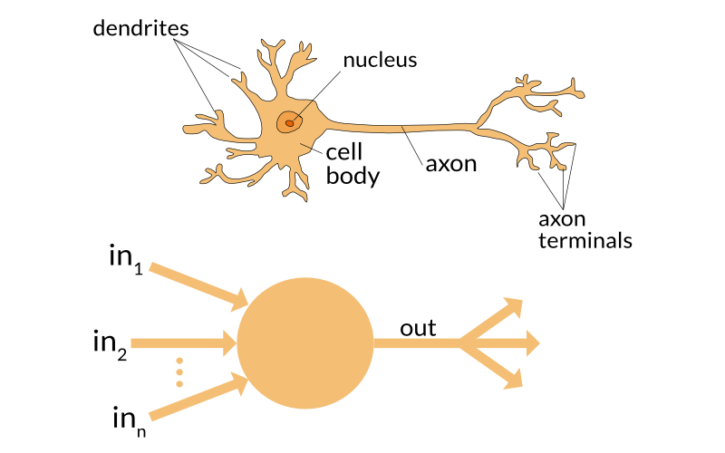

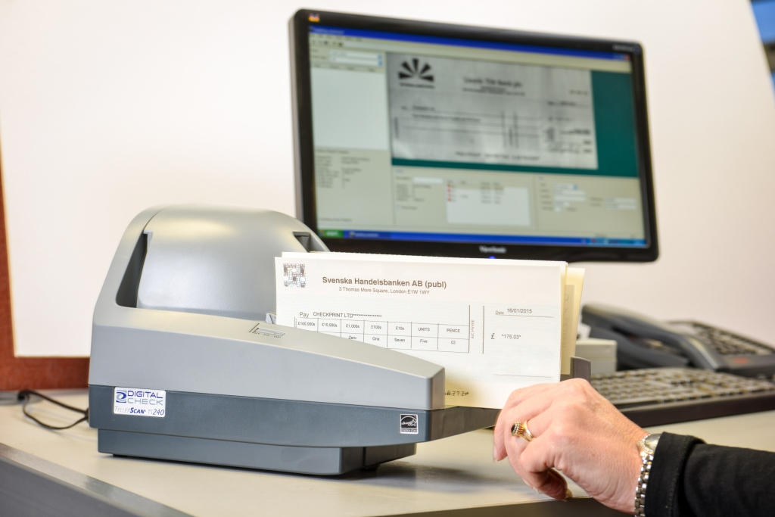
History
1943 – Pitts McCulloch
1958 – Perceptron
Simplistic simulation of neurons
Simple problem solving
1970s-1990s
AI booms and busts
Moore’s law
“Neural Networks”
Geoff Hinton - backpropagation
1990s-2012
Google
“Intelligent agents”
Industrial applications
10-20% of checks processed by machines
Speech recognition
GPU processors

Slide 3
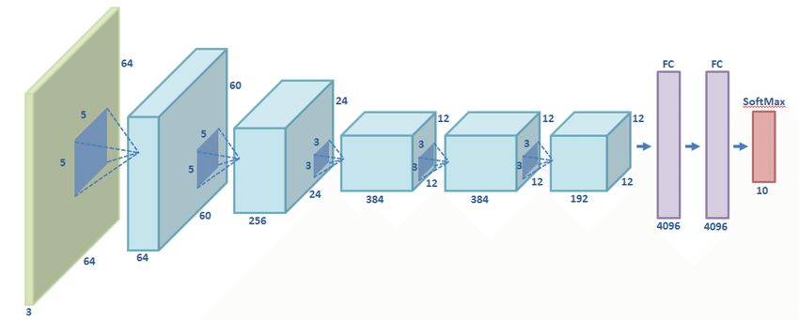
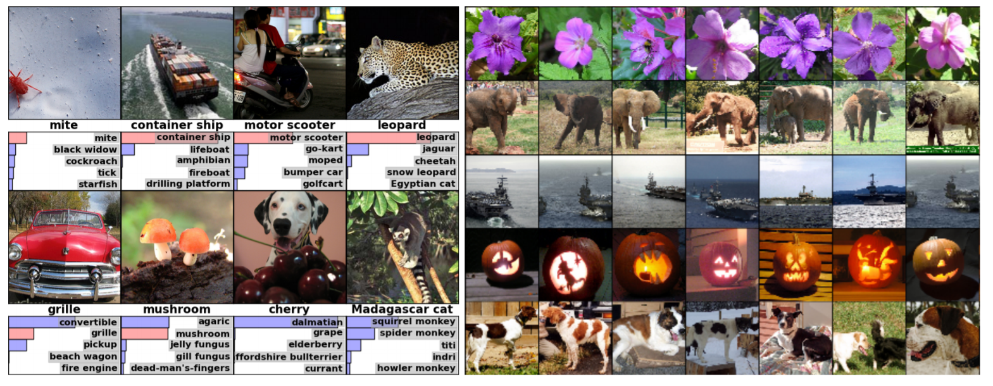
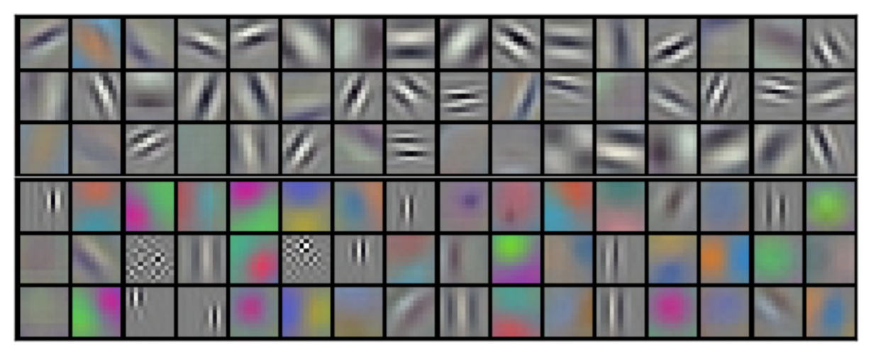
The AI revolution
Deep Learning
Convolutional neural networks
2011 – Schmidhuber – super-human performance of CNNs in handwriting classification
2012 – molecule-target interactions
2012 – AlexNet - Image classification
top-5 error of 15.3% (vs. 26.1% runner-up)

Slide 4
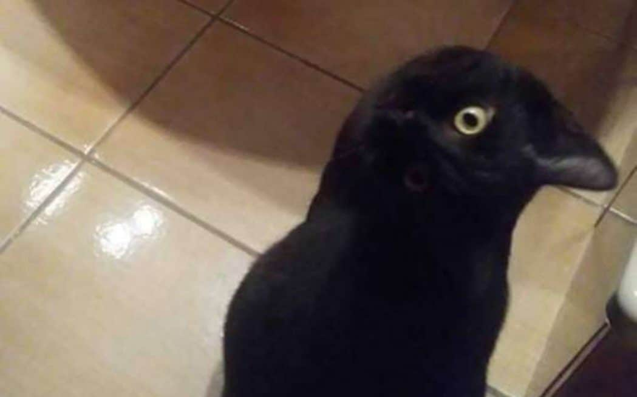
Deep learning approaches
Data-based vs. Model-based
How do you define a cat?
Model based:
Find features likely to belong to a cat
Build a model of the cat based on the existence of features
Very difficult to define, many “gray” areas
Limited to the engineer’s abilities and imagination
“understandable”
Data based:
Generate many examples of cats vs. non-cats – “ground truth”
or:
Generate many unlabeled examples with a good measure of success
Use statistical techniques to extract “catlike” features
Use same techniques to string features together into a cat model
Difficult to obtain high quality GT
Models are difficult to interpret – take it or leave it.

Slide 5
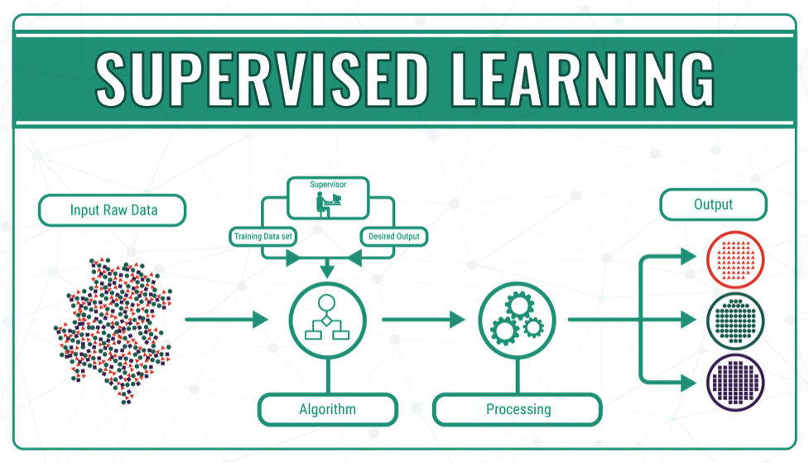
Supervised learning
Examples:
Classification
Given an image – is it a cat? Answer: Y/N
Regression
Given a sequence of locations in the past – what is a likely location in the future? Answer is a set of values
Classification + Regression:
Given an image, find all vehicles and fit each with a bounding box

Slide 6
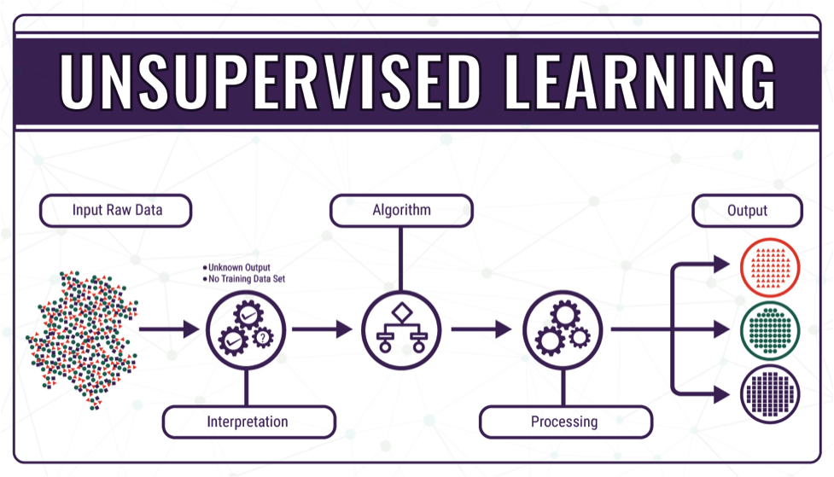
Unupervised learning
Clustering
Good measures exist; find useful features to use for clustering
Compression
Success is easy to measure; finding good ways to succeed is difficult
Anomaly detection
By definition hard to get good labeled data
Blind signal separation
GANs, SOMs
More similar to the way real brains work

Slide 7
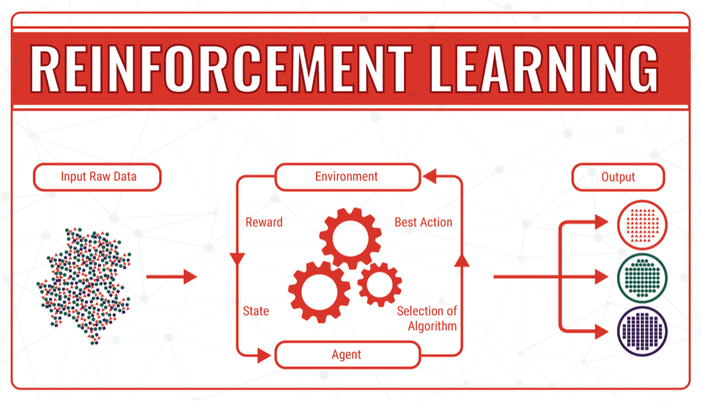
Reinforcement learning
Measure-and-control environments
Success is easy to define; how to achieve it is difficult

Slide 8
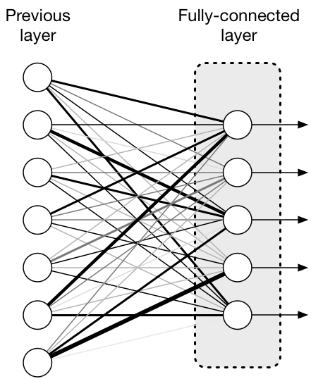
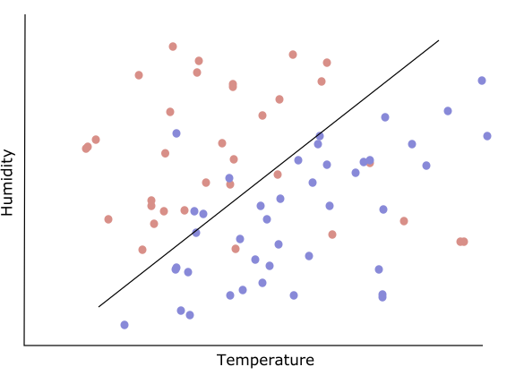
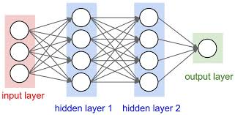
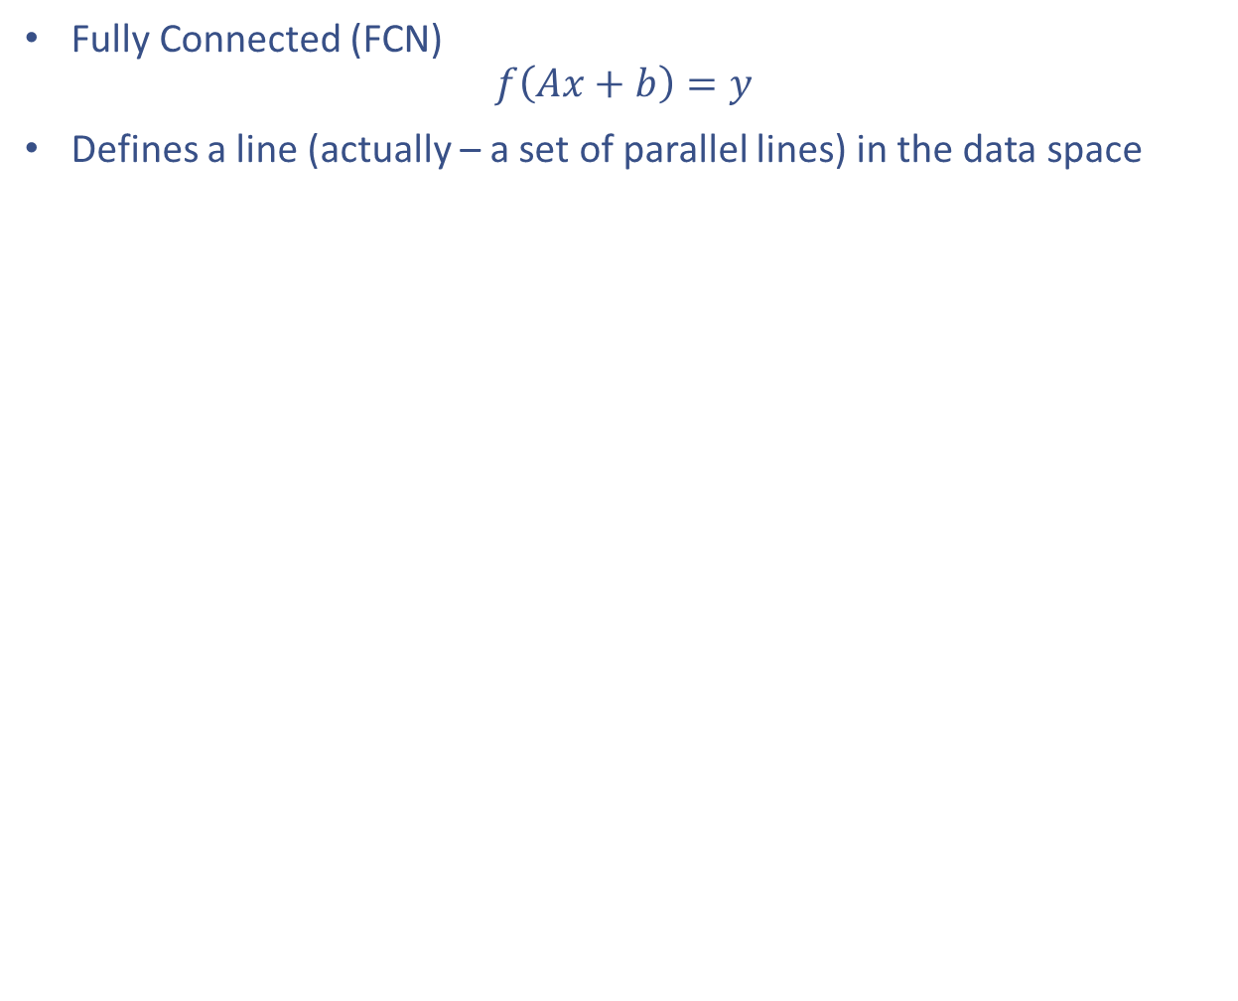
Model types
Fully Connected (FCN)
$$f\left(Ax+b\right)=y$$
Defines a line (actually – a set of parallel lines) in the data space

Slide 9

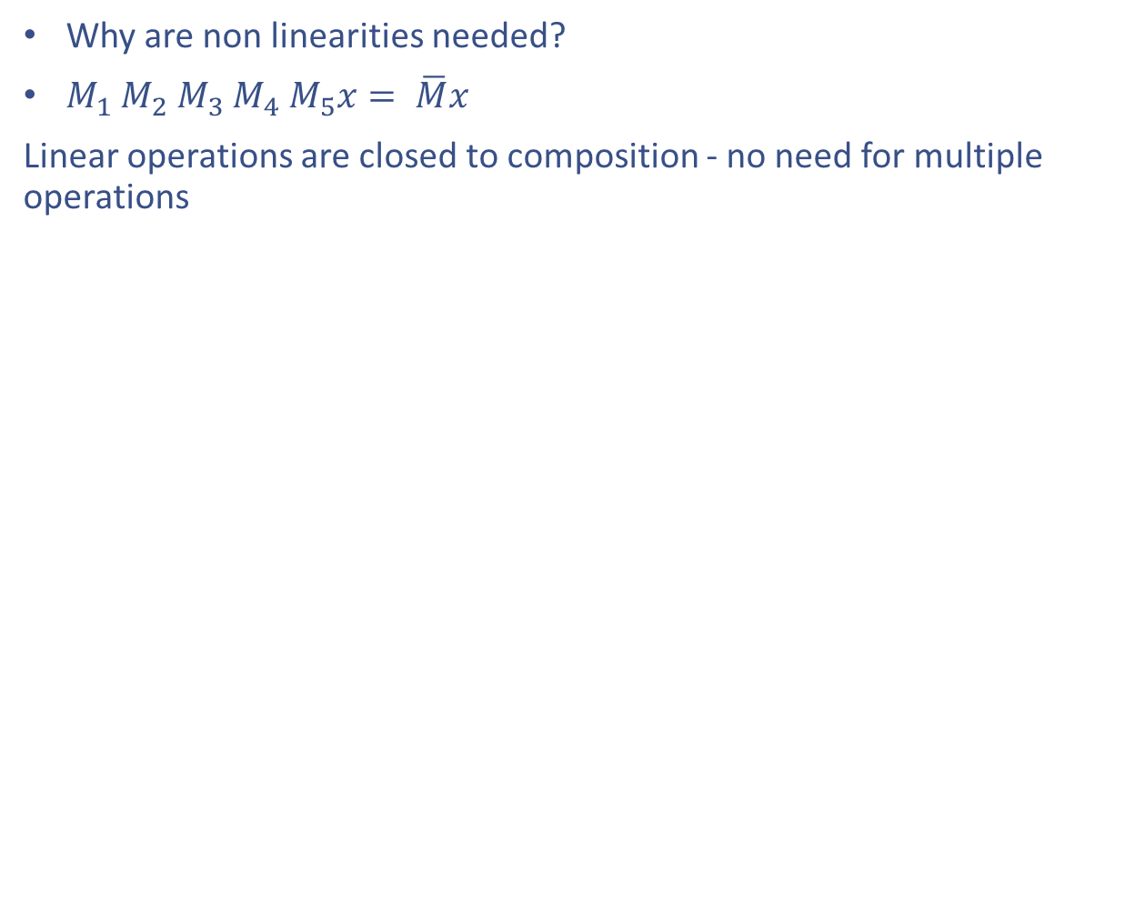
Non-linearities
Why are non linearities needed?
$M_{1}$ $M_{2}$ $M_{3}$ $M_{4}$ $M_{5}x= \overline{M}x$
Linear operations are closed to composition - no need for multiple operations

Slide 10

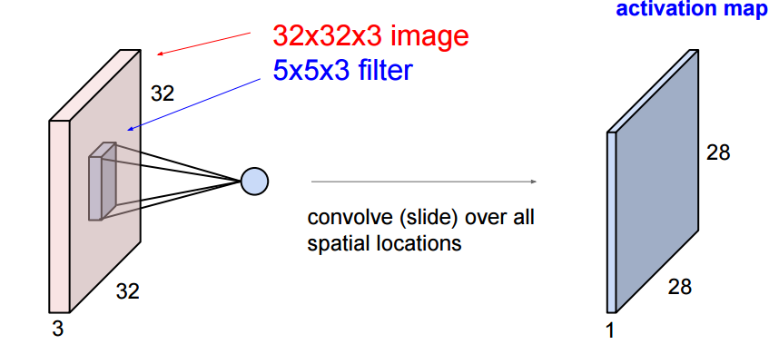
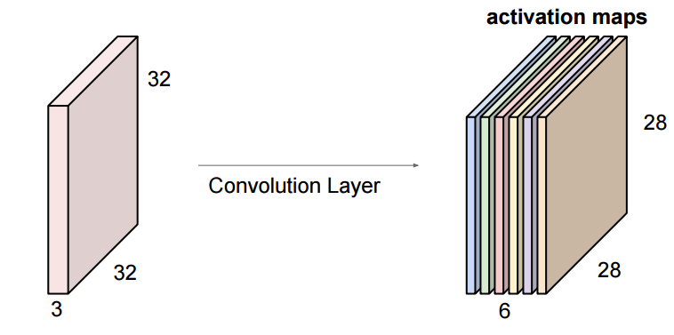

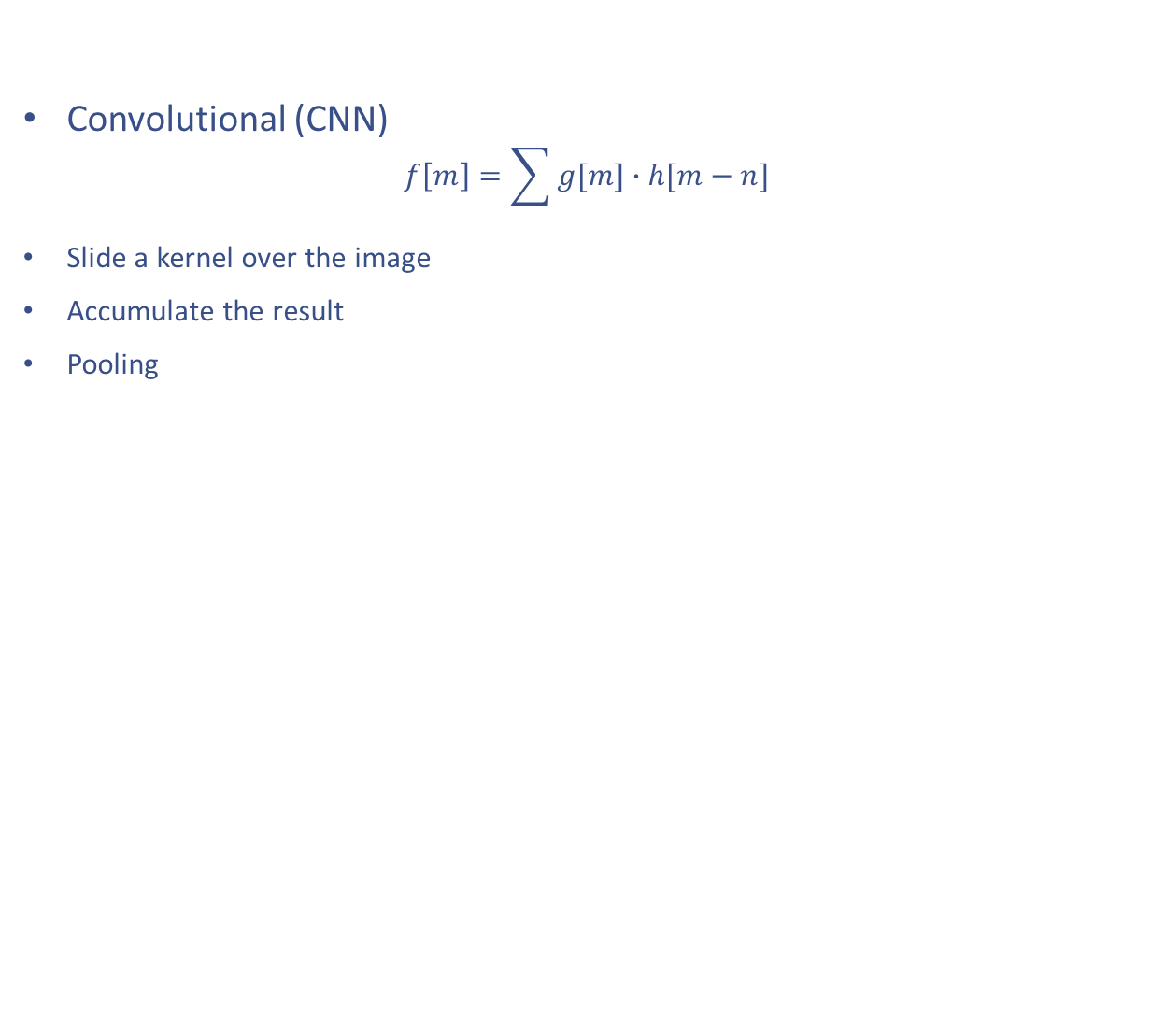
Convolutional (CNN)
$$f\left[m\right]=\sum{g[m]∙h[m−n]}$$
Slide a kernel over the image
Accumulate the result
Pooling

Slide 11
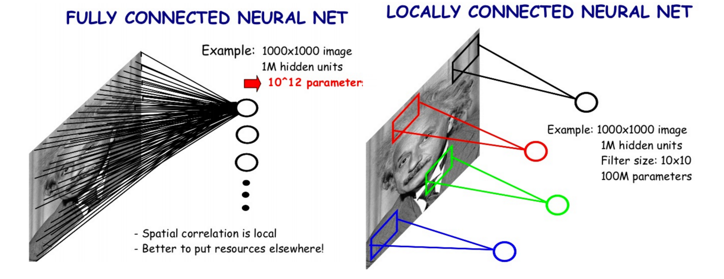
Fully connected vs. Convolutional
Fewer parameters
Agnostic to location in image (pro/con)
“locally fully connected”

Slide 12
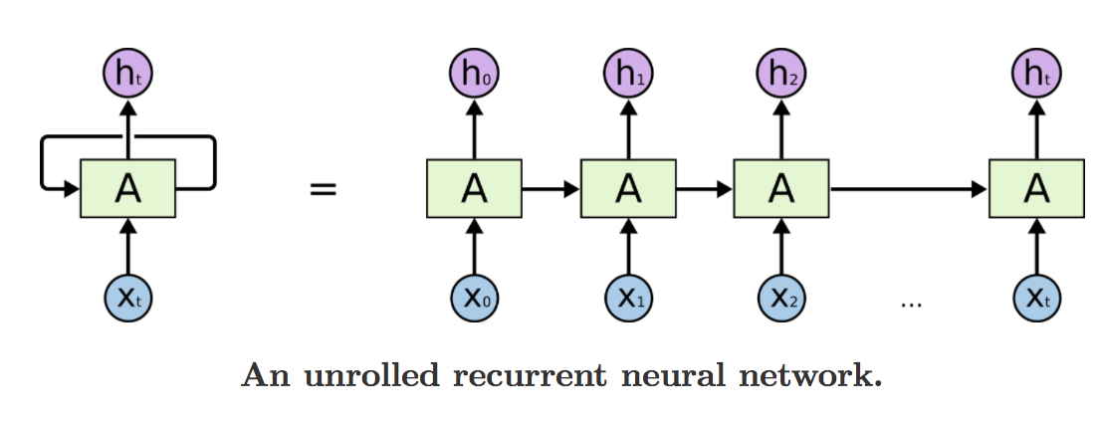
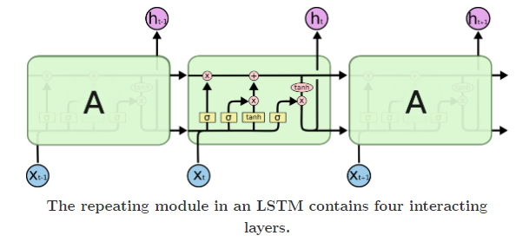
Recurrent Neural Network
Time series

Slide 13
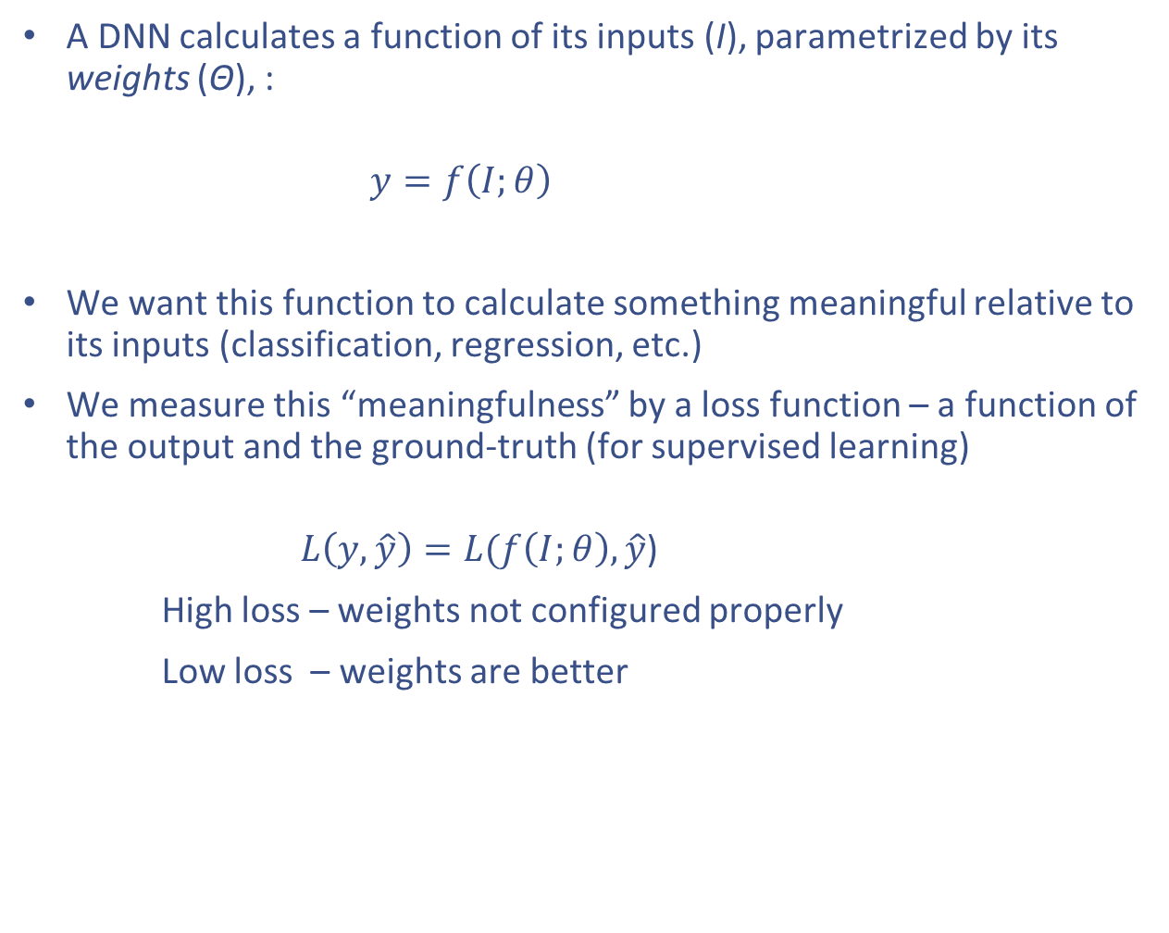
Loss function
A DNN calculates a function of its inputs (I), parametrized by its weights (Θ), :
$$y=f\left(I;θ\right)$$
We want this function to calculate something meaningful relative to its inputs (classification, regression, etc.)
We measure this “meaningfulness” by a loss function – a function of the output and the ground-truth (for supervised learning)
$L\left(y, \hat{y}\right)=L(f\left(I;θ\right), \hat{y}$)
High loss – weights not configured properly
Low loss – weights are better
The objective: Minimize the loss function

Slide 14
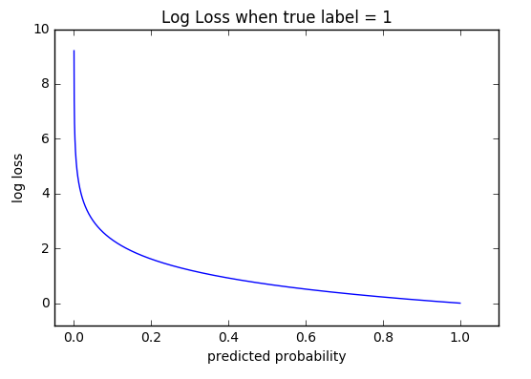
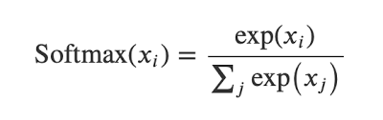
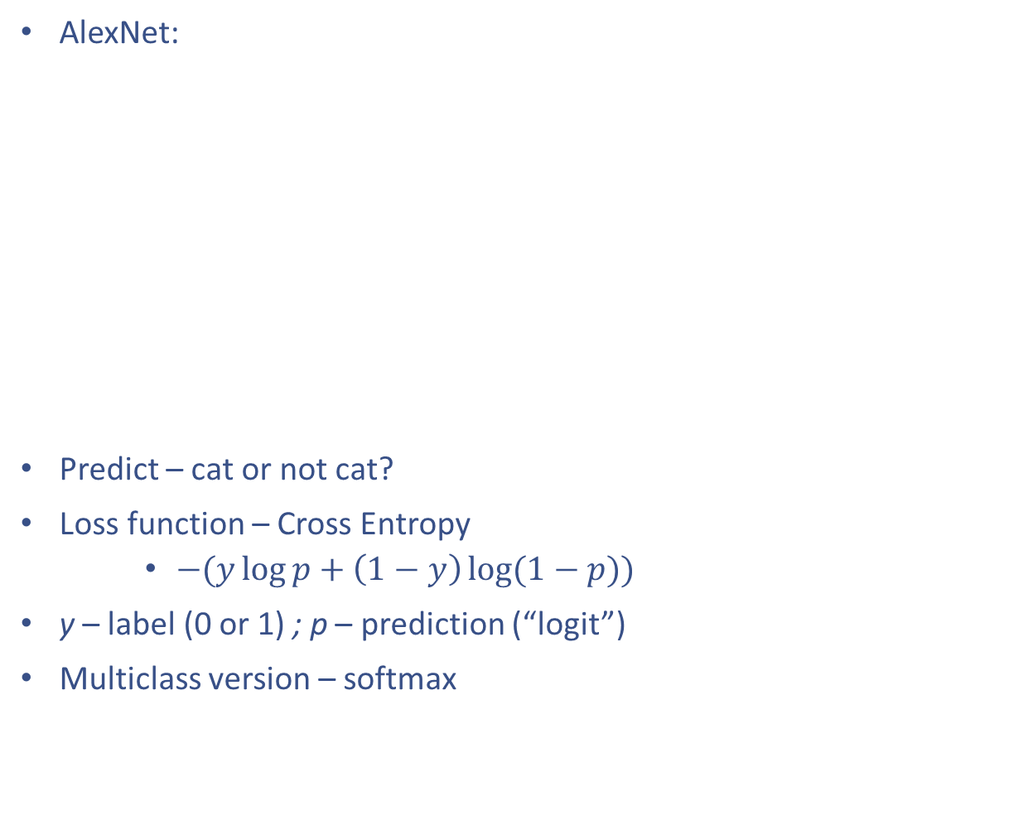
Loss functions
AlexNet:
Predict – cat or not cat?
Loss function – Cross Entropy
$−(y\log{p+\left(1−y\right)\log{(1−p)}})$
y – label (0 or 1) ; p – prediction (“logit”)
Multiclass version – softmax

Slide 15
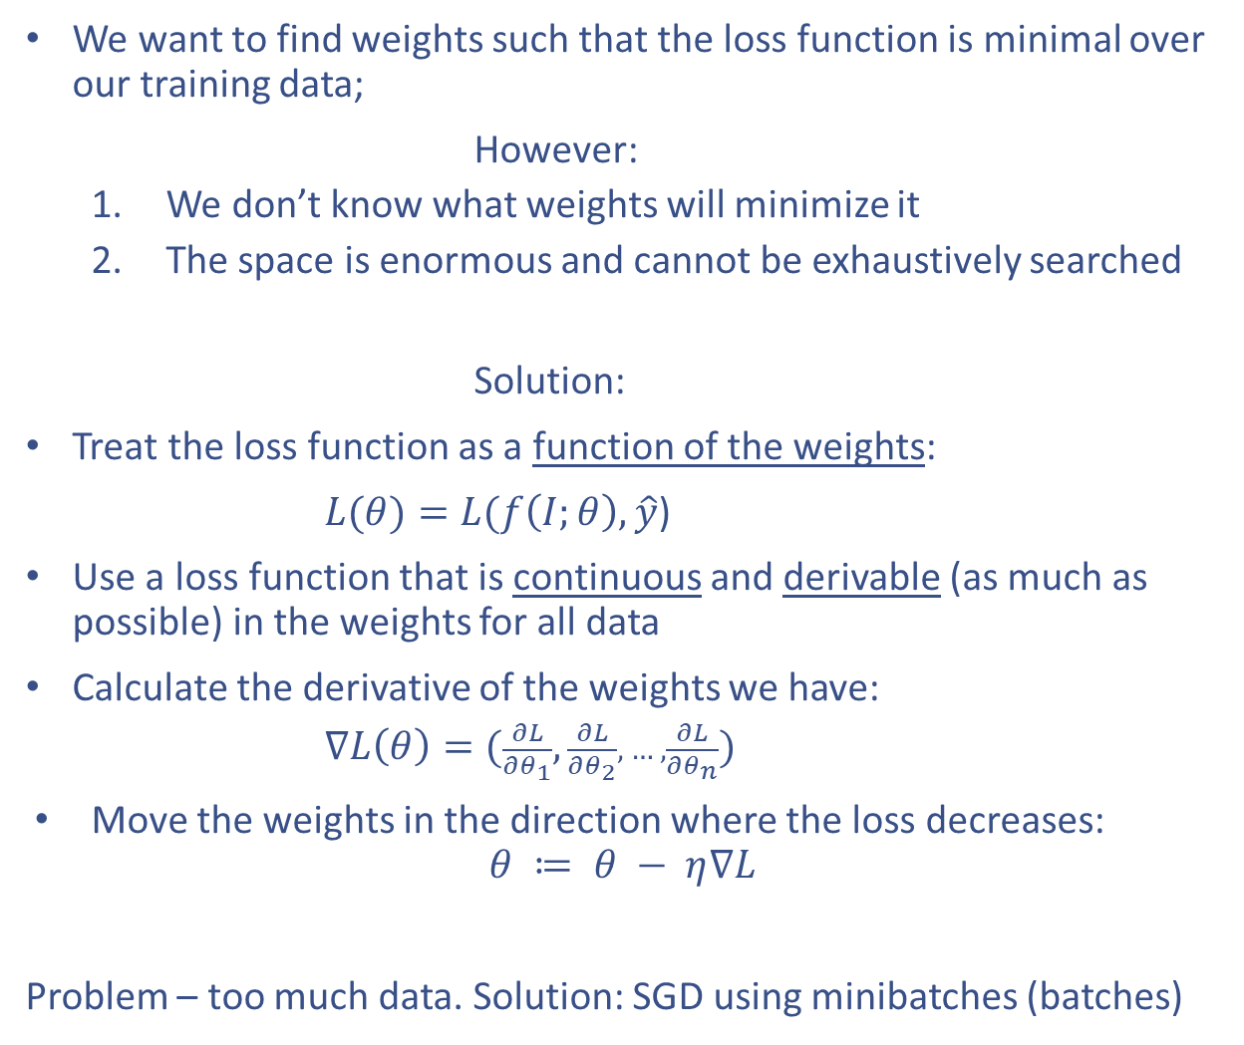
Gradient descent
We want to find weights such that the loss function is minimal over our training data;
However:
We don’t know what weights will minimize it
The space is enormous and cannot be exhaustively searched
Solution:
Treat the loss function as a function of the weights:
$L(θ)=L(f\left(I;θ\right), \hat{y}$)
Use a loss function that is continuous and derivable (as much as possible) in the weights for all data
Calculate the derivative of the weights we have:
$∇L\left(θ\right)=(\frac{∂L}{∂θ_{1}},\frac{∂L}{∂θ_{2}}, … ,\frac{∂L}{∂θ_{n}})$
Move the weights in the direction where the loss decreases:
$$θ ≔ θ − η∇L$$
Problem – too much data. Solution: SGD using minibatches (batches)

Slide 16
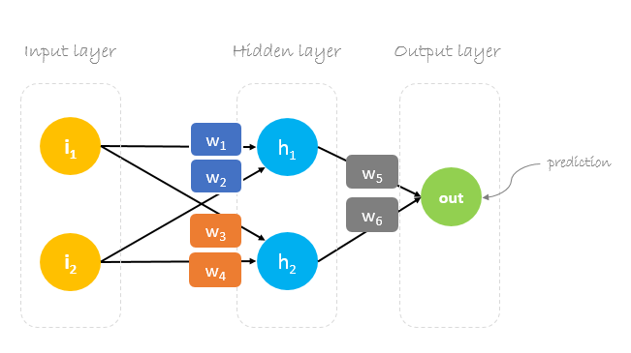
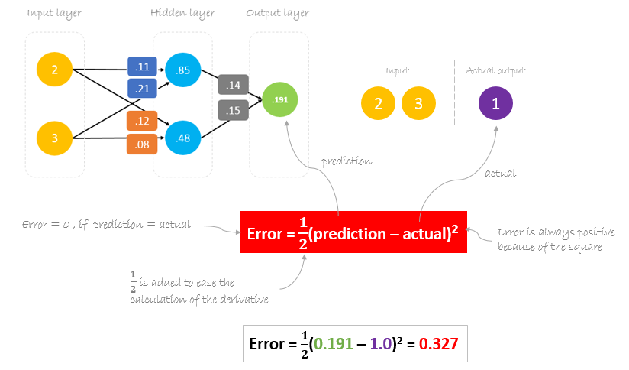
Gradient descent
How does this look like?

Slide 17
Deep Learning
From theory to practice

Slide 18
Common problems
==== > Jupyter Notebook

Slide 19
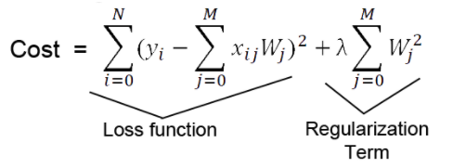

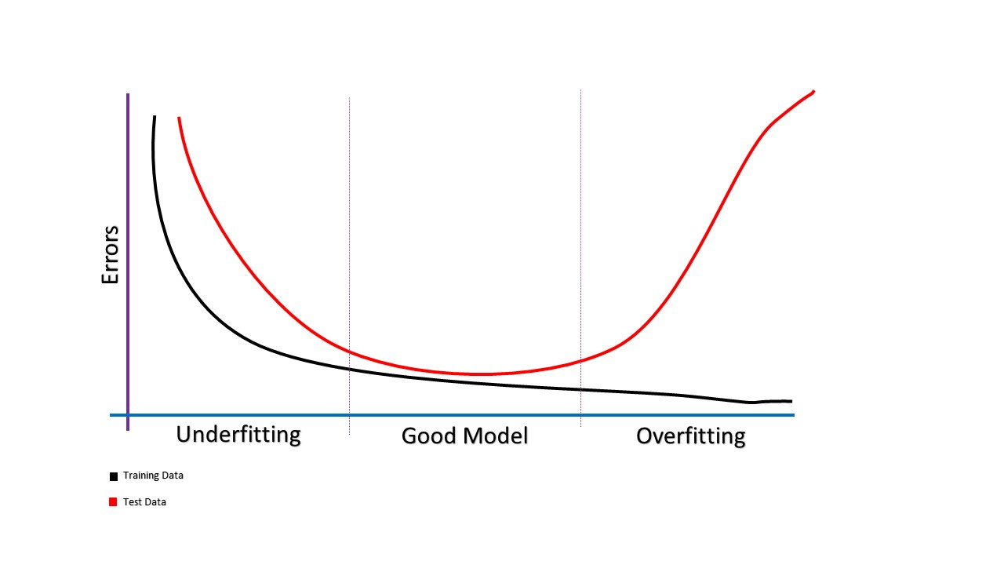
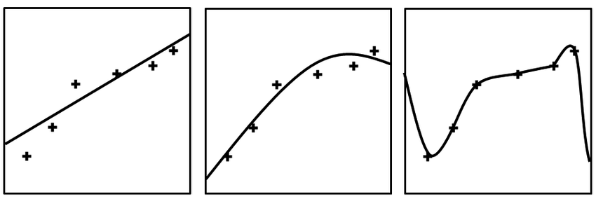
Common problems with Deep Learning models
Input bugs – data types, shape
Architecture bugs
Model too weak → underfitting
Model too strong → overfitting:
Weaken the model
Regularization – “conditional” weakening, L1/L2
Data problem
Not enough data (training data does not generalize to unseen data)
Data not sampled properly.

Slide 20
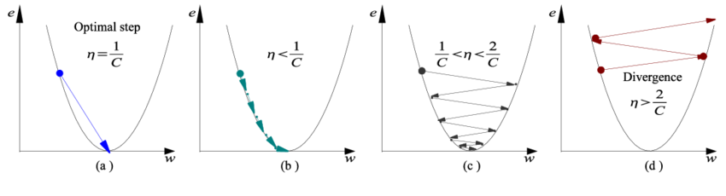

Common problems with Deep Learning models
Effect of learning rate on learning convergence:
Learning rate scheduling

Slide 21
Common problems with Deep Learning models
Model too deep – vanishing gradients
ReLU/Leaky ReLU can help
Skip connections
Converging to local minimum:
Different weight initialization
Learning rate scheduling with large increases
Larger batches
Different optimizer
Loss function:
For regression – consider custom
For classification – focal loss?

Slide 22
Environment
Set up jupyter notebooks
In the virtual environment, install:
keras
numpy
Seaborn
Clone the notebook from:
https://github.com/YishGene/cnn_min_course.git

